Slide 1
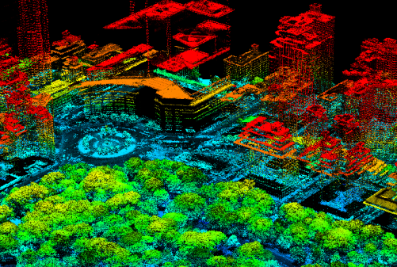
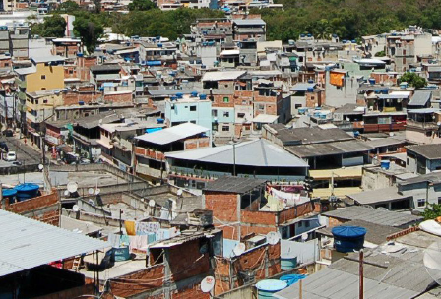
Neighborhood Influences on Health: New York City and Rio das Pedras
Andrew Rundle, Hilary Sample, Gina Lovasi, Kathryn Neckerman, Karen Lee & Studio X Rio de Janeiro
Mailman School of Public Health & The Graduate School of Architecture, Planning and Preservation
Columbia University

Slide 2

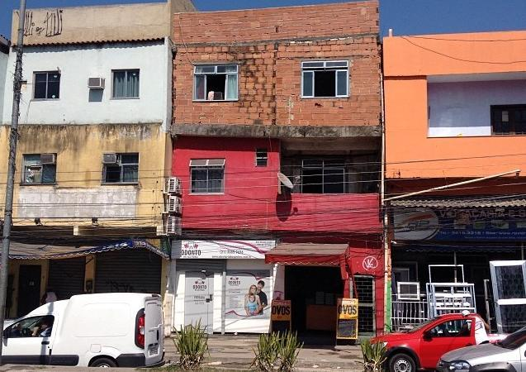
Neighborhood Influences on Health: New York City and Rio das Pedras
Andrew Rundle, Hilary Sample, Gina Lovasi, Kathryn Neckerman, Karen Lee & Studio X Rio de Janeiro
Mailman School of Public Health & The Graduate School of Architecture, Planning and Preservation
Columbia University

Slide 3
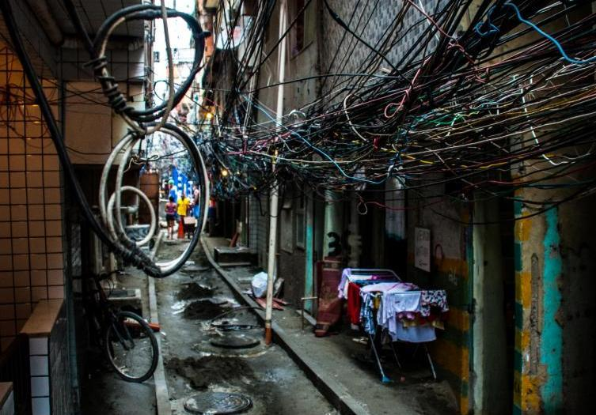
Neighborhood Influences on Health: New York City and Rio das Pedras
Andrew Rundle, Hilary Sample, Gina Lovasi, Kathryn Neckerman, Karen Lee & Studio X Rio de Janeiro
Mailman School of Public Health & The Graduate School of Architecture, Planning and Preservation
Columbia University

Slide 4
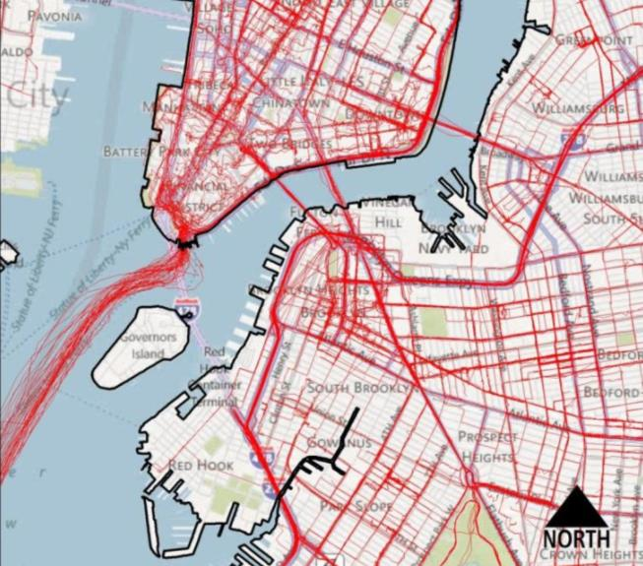
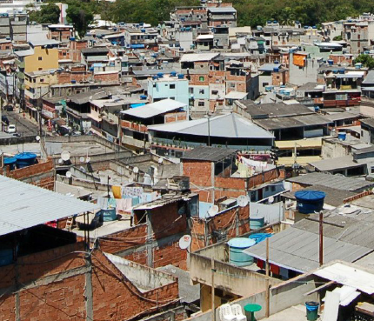
Neighborhood Health: NYC to RdP
Understanding the role of urban form and design in promoting physical activity and health in NYC.
Transferring our methods for neighbor health research to Rio das Pedras, the 3rd largest Favela in Rio de Janeiro.

Slide 5
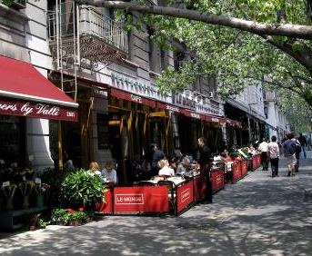
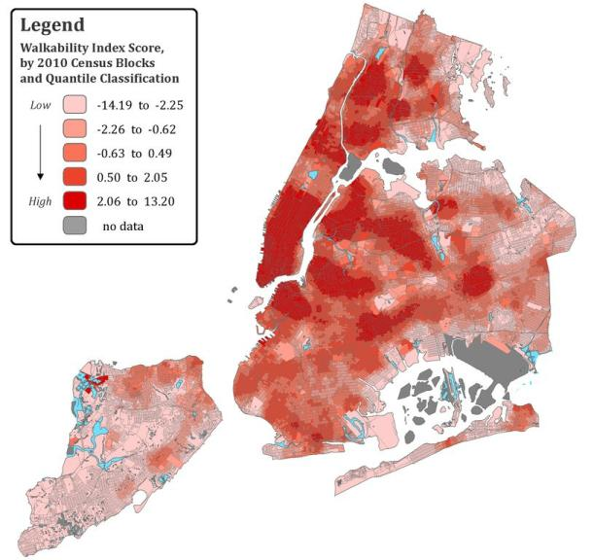
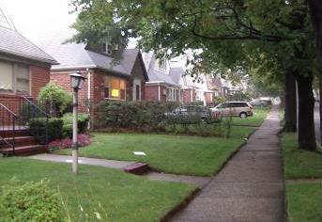
Neighborhood Walkability: an Urban Form Perspective
High Walkability
Low Walkability
The ‘Ds’: Density, Diversity, Design & Destinations

Slide 6
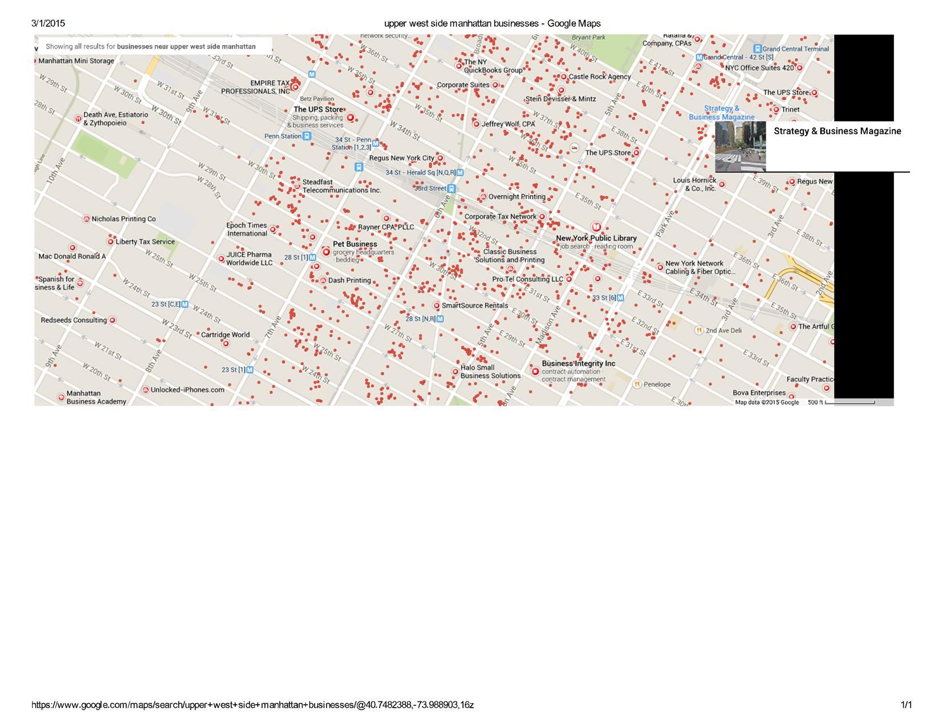
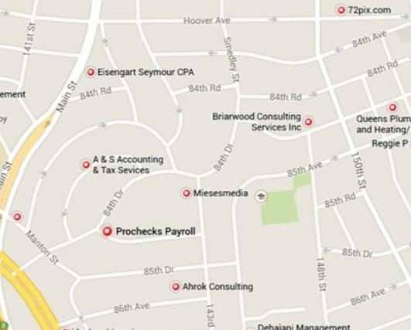
Neighborhood Walkability: an Urban Form Perspective
High Walkability
Low Walkability
The ‘Ds’: Density, Diversity, Design & Destinations

Slide 7
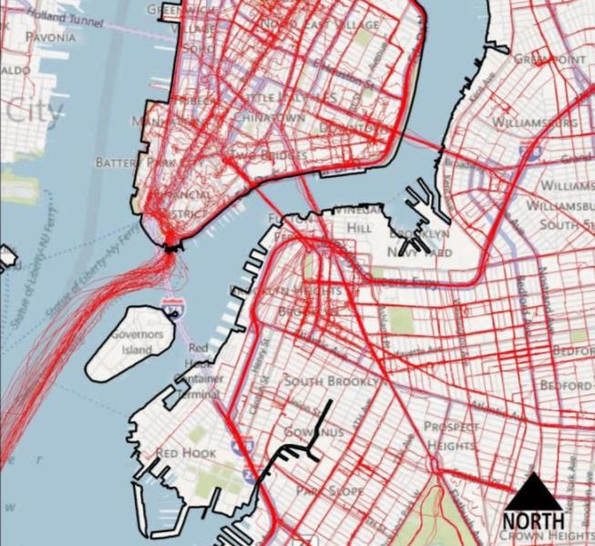
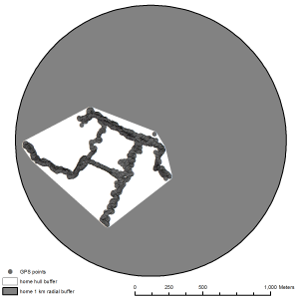
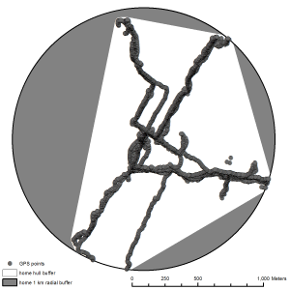
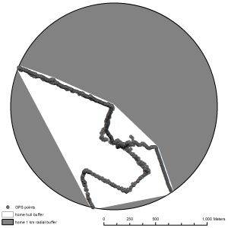
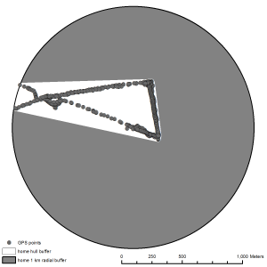
Understanding How Urban Form
Affects Mobility and Physical Activity
GPS and physical activity monitoring for a representative sample of New Yorkers.

Slide 8
Residents Use the Most Walkable Parts of Their Neighborhoods
Total area within 1Km of home
Area used within 1Km of home
Area not used within 1Km of home

Slide 9

Weekly Physical Activity is Associated with Neighborhood Walkability
Neighborhood Walkability Scale Score
Results adjusted for gender, age, race/ethnicity and self-rated health, neighborhood household income and homicide rate.

Slide 10
Weekly Physical Activity is Associated with Neighborhood Walkability
Neighborhood Walkability Scale Score
Results adjusted for gender, age, race/ethnicity and self-rated health, neighborhood household income and homicide rate.

Slide 11
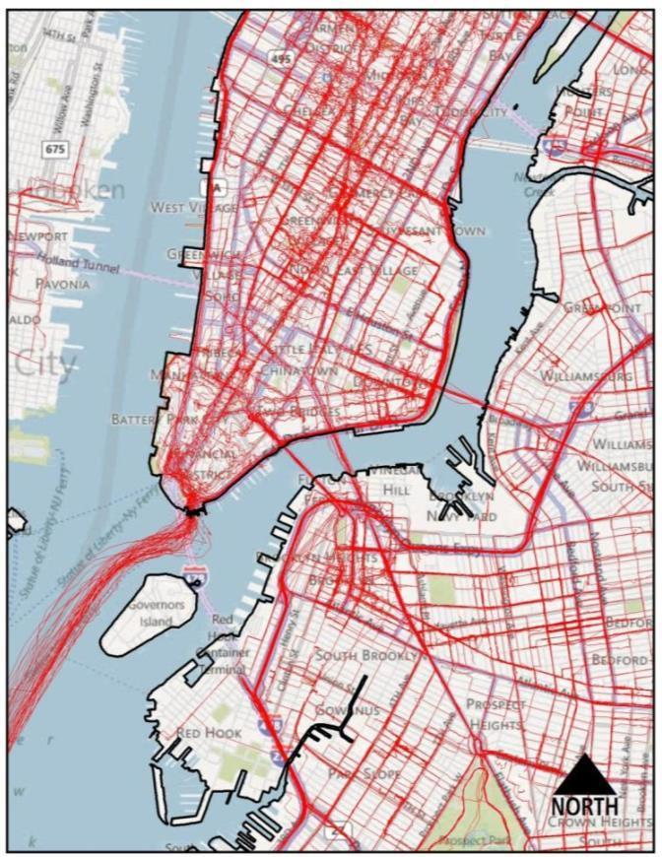
Expanding the Concept of ‘Walkability’ Beyond Urban Form
Physical Activity Across the Health-Scape
Walkability
Urban form
Crime
Pedestrian safety
Physical disorder
Aesthetics
Street life
Street trees
Green space

Slide 12
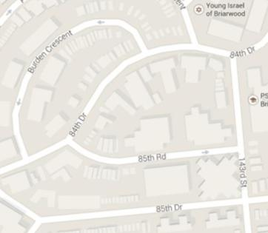










Expanding the Concept of ‘Walkability’ Beyond Urban Form
Physical Activity Across the Health-Scape
Walkability

Slide 13
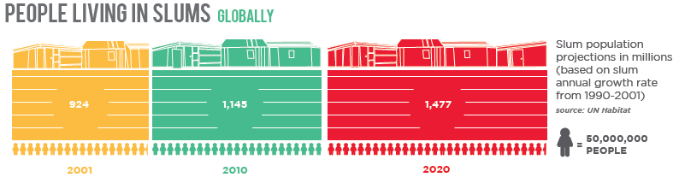
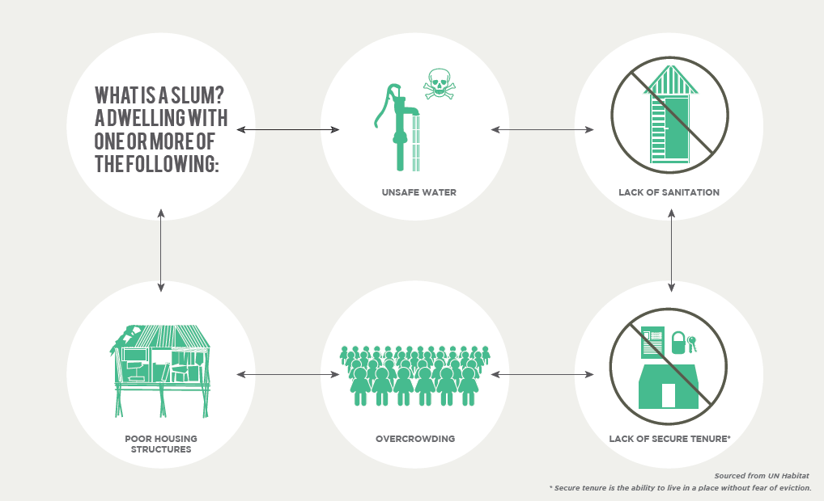
Neighborhood Health Effects Research in Resource Constrained Areas

Slide 14
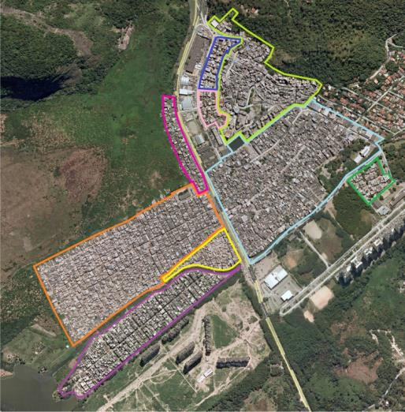
Rio das Pedras,
Rio de Janeiro,
Brazil
A vibrant community home to 63,000+ residents
Infrastructure challenges:
Open sewer
Seasonal flooding
Heavy vehicle traffic
Single health clinic
No official addresses
Informal access to city services
Militia provide services and order
1984
1990
2013

Slide 15
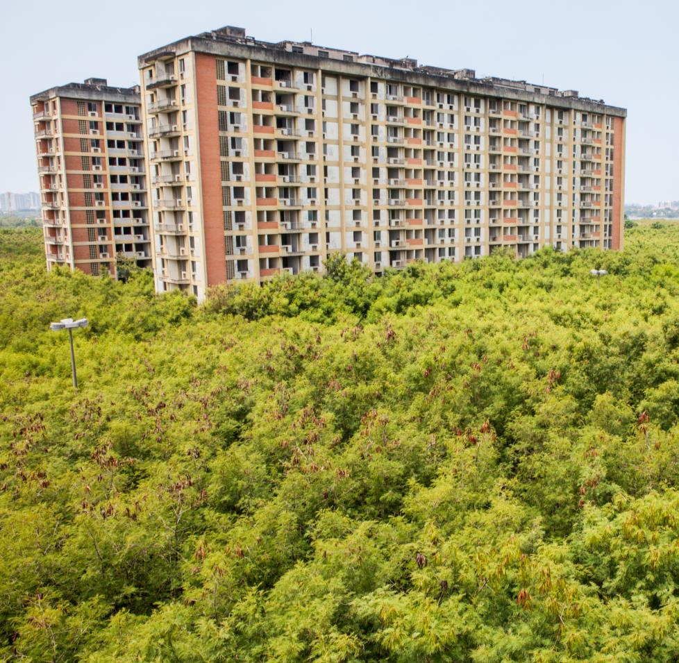
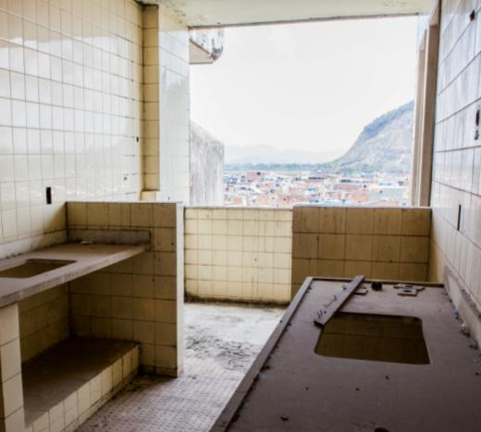
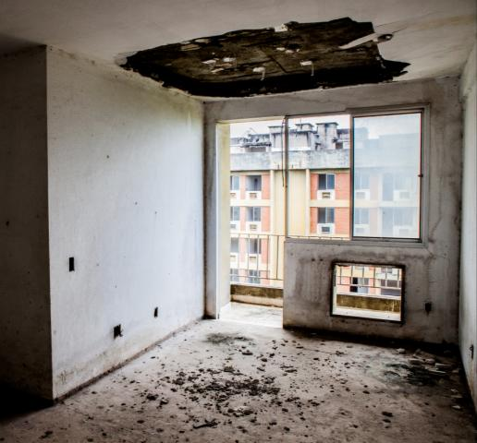
Design Studios for Rio das Pedras

Slide 16
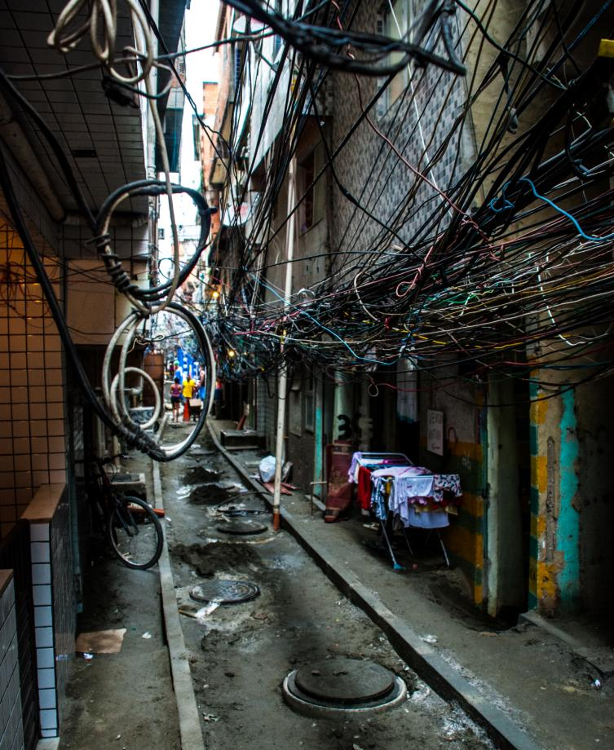
Testing, Adapting and Deploying Our Methods in Rio das Pedras
Population health surveys
Qualitative interviews
Mobility studies (GPS/GIS)
Systematic Social Observation/Neighborhood Audits
Biospecimen collection
Environmental sampling
Identify individual and collective resiliency strategies arising in the face of infrastructural challenges.

Slide 17





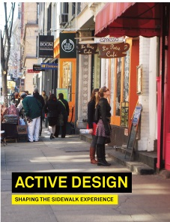



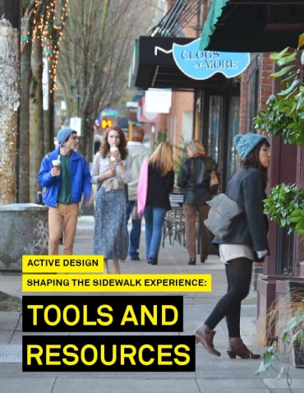

Partners
Núcleo de Cidadania
de
Rio das Pedras
Translation and Dissemination
PERKINS + WILL

